Slide 1

Finding a good
neighborhood in
Scarborough

Slide 2
Introduction
Finding a good neighborhood is a human’s instinct.
Using several tools, it’s possible to help people who want to move into Scarborough, Canada to find a good place to live.
To identify a good neighborhood, weather conditions, housing price, road connectivity, proximity to a park and so on must be considered.

Slide 3
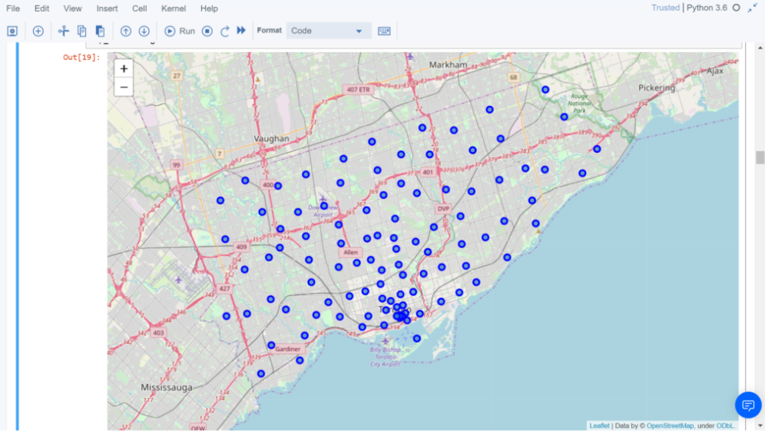
Map of Scarborough

Slide 4
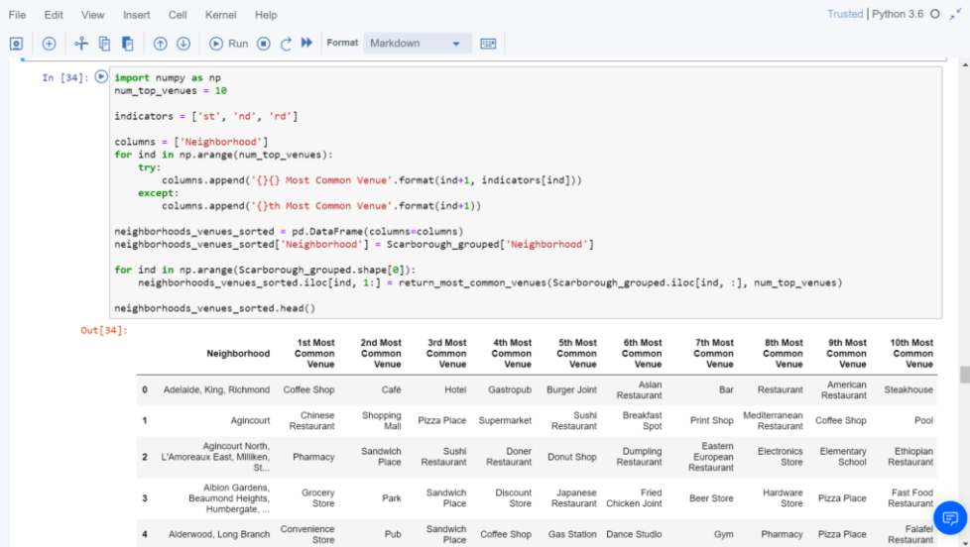
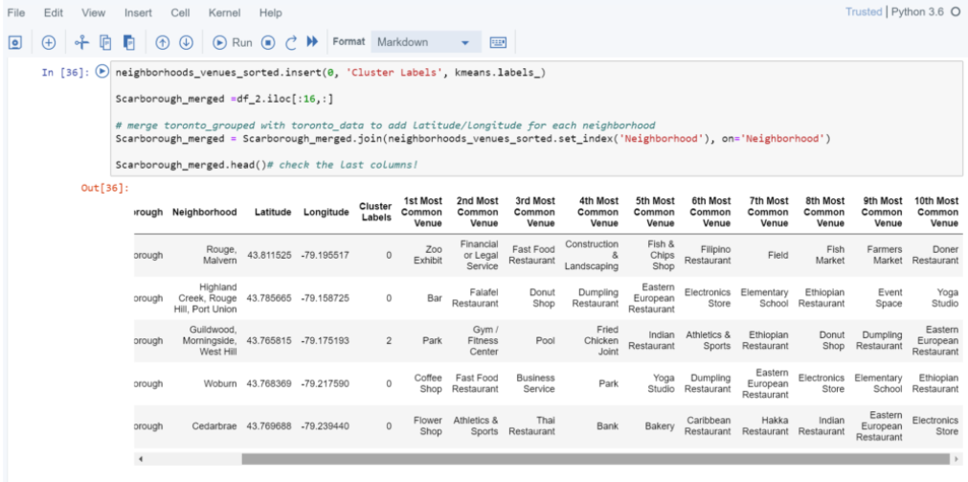
Methodology
Clustring
Using K-means

Slide 5

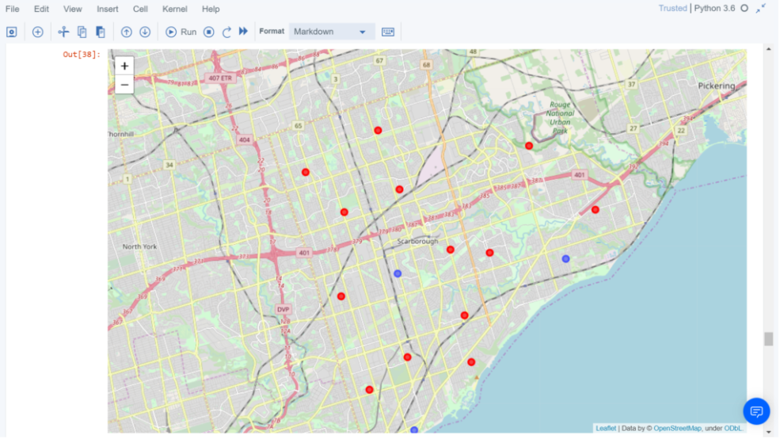
Conclusion 1
→ Separated into 10 sections

Slide 6
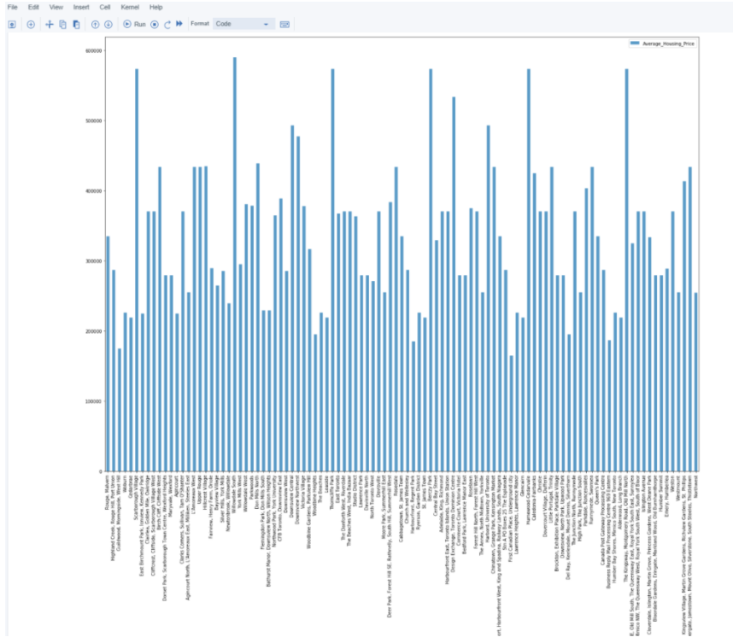
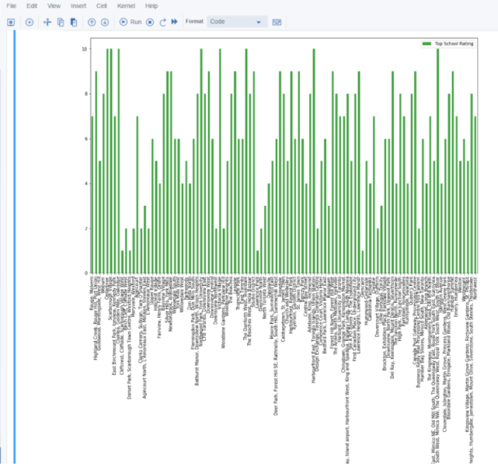
Conclusion 2)
housing price
School ratings

Slide 7
Future Work
With more values, such as the exsitence of the park, road congestion, the result will be more accurate.
It’s proven that finding a solution for real world problem is possible from the project. Likewise, when it comes to figuring out the result in huge volumn of the dataset, using science tools is very efficient.

